Slide 1

Capstone Project
Coronary Heart Risk
By Oliver Tang

Slide 2
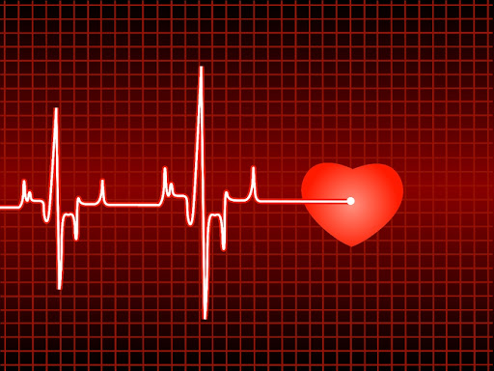
Agenda
01
Executive Summary
Problem statement; Objectives; Overview of key Methods; Insights and Recommendations
02
Approach
Logical steps to final model selection
03
Model Comparison and implementation
Model performance comparison and metrics explained, with the best performing model selected
04
Business Insights and recommendations
Relevance and implementability of the conclusions and recommendations

Slide 3
Executive Summary
“Coronary Heart Disease (CHD) is now the leading cause of death worldwide” (The British Heart Foundation, 2019)
Key data optimization strategy
Socio-economic
Objective
Impacts are wide in society ranging from public health; government policy; patient costs; personal lifestyle and well-being
Training data; feature scaling; balancing data; pruning; K-Fold X validation; multicollinearity; minimizing overfitting
Problem
Data science led approach for predicting CHD in ten years.
In Europe CHD accounts for an estimated 1.95 million deaths each year.
1
2
3
4
5

Slide 4
Approach: Logical steps to final model selection
Grouped Variables
Data Pre-Processing
Cramer’s V
• Demographic
• Behavioural
• Medical history
• Current medical
Removal of unwanted variables
Missing Value Treatment
Outlier Treatment
Multi-collinearity PCA
Analysis of correlation between nominal values.
Light EDA
Univariate / Bivariate analysis
EDA after Data Pre-Processing
Understanding the dataset and identifying any challenges or issues that could potentially arise:
The original dataset had 16 variables and 4,420 observations.
As part of light EDA to check for correlation between all the variables.
Visual relationship among important variables.

Slide 5
Approach: Logical steps to final model selection
Interesting moments
Most smoke < 5 cigs per day; usually men, and men have a higher risk of getting CHD within ten years than women + have a high history of stroke.
Smoking more cigs per day doesn’t lead to higher predicted heart disease. It has to be considered with other factors.
Currently most people have high cholesterol and are overweight but they don't have any serious medical stroke or blood pressure history.
Men have a slightly higher BMI than women
The less educated a person is, the more likely they are to smoke.
Positive correlation: hypertensive history and blood pressure medication.
Positive correlation: hypertensive history and being predicted to get CHD within ten years.
Positive correlation: diabetes and being predicted to get CHD within ten years
The older a person is, combined with higher than normal BMI, cholesterol levels, smoking, and have a higher systolic and diastolic BP, shows a person is more likely to get CHD within ten years.
Age is more highly correlated with systolic BP than diastolic BP.
BMI alone is also strongly correlated with systolicBP / diastolic BP.
Strong correlation: high glucose levels and diabetic history and if combined with high systolicBP / diastolic BP and high cholesterol, CHD risk increases.
Strong correlation: BMI and historical blood pressure medication.
Blood glucose is highly related to diabetes; diabetes is also related to other health factors such as high blood pressure, etc., and this in turn has knock-on effects, and this makes the situation a little more complicated than simply imputing the average.
9.15%
SMOTE
Outliers
Missing Glucose Values
Imbalanced Classification
The 3 Causes
'Missing Completely at Random’ Only 388 missing Glucose values, I could manually filter the raw csv file and quickly eyeball them for a sanity check and formulate a plan.
positive prediction "1" is greatly outnumbered by negative prediction "0". Common problem in data science; leads to inaccuracy in data modelling later if not treated.
1) Data entry or measurement errors:
2) Sampling problems and unusual conditions
3) Natural variation

Slide 6
Approach: Logical steps to final model selection
Training and Testing Set Split
Grid-search parameter tuning for SVM
75% for the training set and 25% for the testing set, most of the data is used for models to learn from before comparing the accuracy of the outputs to the test data.
.
Create a grid of hyper-parameters and test all combinations. Once parameters are chosen, they are imputed them into the SVM which was also K-Fold Cross Validated.
Business Understanding
Data Understanding
Feature scaling
Applied to independent variables. Normalizes the data within a particular range. Helps speed up algorithm and optimize accuracy of predictions.
K-Fold Cross Validation
How accurate is the model?
I passed the models through an algorithm called K-Fold Cross Validation to ensure that every observation from the original dataset has the chance of appearing in training and test set.
Deployment
Modelling
Data Preparation
Thresholds
Minimizing overfitting
SMOTE balanced the data in target variable, but meant I had significant amount of fake data. So, I raised the threshold accuracy for correctly identifying positive “Yes” cases to 75% rather than the usual 50% to ensure I caught as many true positive cases as possible.
A model that has been overfit has poor predictive performance, as it overreacts to minor fluctuations in the training data. (All steps here as well as ensemble techniques and removing unwanted ‘Education’ variable helps to deal with overfitting.

Slide 7
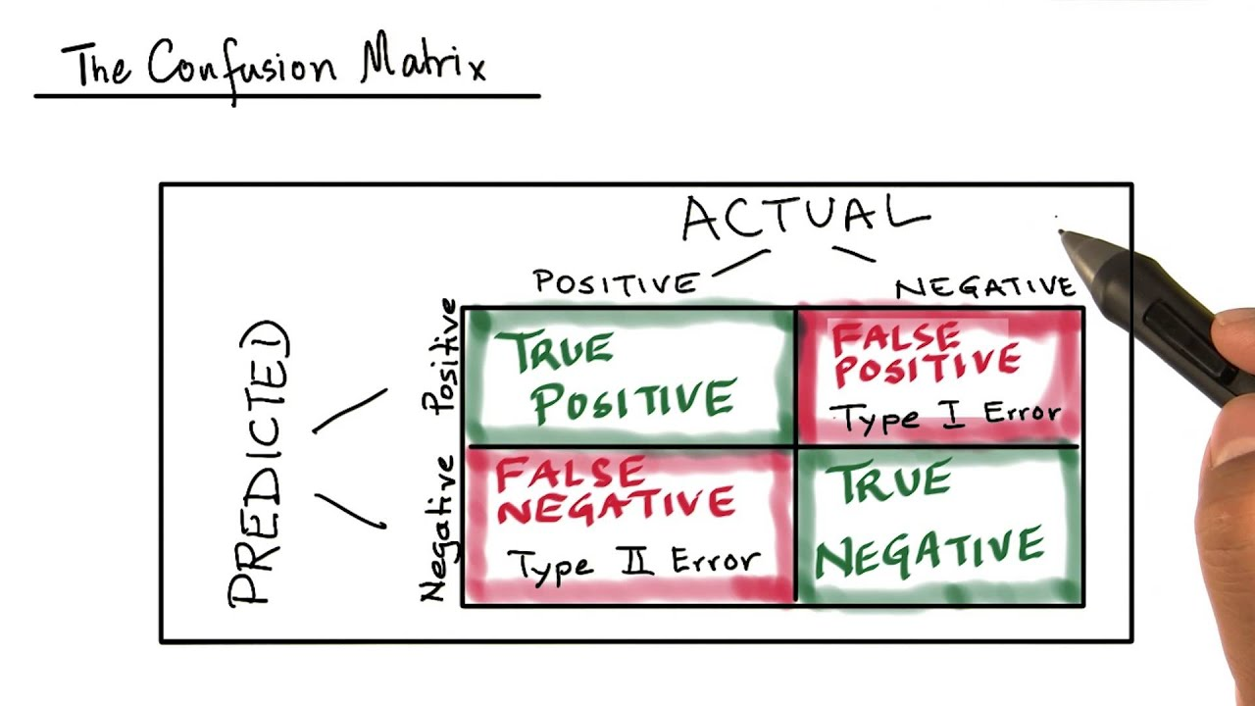
Model Comparison and implementation
Confusion Matrix:
Other Criteria:
This will be the main crux of outputs for evaluating models to describe the performance of our classification models on test data for which the true values are known.
Is the Confusion Matrix the optimal way to evaluate the performance of the model?
No, it just gives you an idea of how well your model can perform. A good confusion matrix with few prediction errors on the test set means your model has a good predictive power.
Combine with K-Fold Cross Validation for accuracy.
Accuracy
Sensitivity or True Positive Rate (TPR)
Specificity (SPC) or True Negative Rate (TNR)
Precision or Positive Predictive Value (PPV)
Negative Predictive Value (NPV)
F1 Score
What I am looking for in an ideal model is to accurately predict CHD and to minimise risk of death, even if that means concurrently getting false positives as those people will eventually find out that they won't contract the disease through follow up tests, though understandably will be inconvenient, or will spur them onto living a healthier lifestyle.
Firstly, high Sensitivity combined with low False Negative Rates to detect those people who are positive will in fact get the disease, while minimise incorrectly telling people they won't get CHD, when in fact they will.
Secondly, high Accuracy rate and a high AUC rate will bolster confidence the model's reliability.
Thirdly, correctly identifying the True Negative Rates, while reducing the False Positives.
False Positive Rate
False Negative Rate
Making Sense of the Confusion Matrix
Sensitivity – 100%
False Negative Rates– 0.56%
Accuracy – 99%
True Negative Rates – 90%

Slide 8
Tried and tested over 15 models:
Logistic Regression Unbalanced
Logistic Regression with SMOTE
KNN Unbalanced
KNN with SMOTE
Naive Bayes Unbalanced
Naive Bayes with SMOTE
Naive Bayes with PCA
Bagging
Boosting
Random Forest Unbalanced
Random Forest with SMOTE
XGBoost
SVM
SVM with Grid Search
Kernel SVM
The “Best” Model
“KNN with SMOTE”
Accuracy = 99.49%
Sensitivity = 100%
Specificity = 99.44%
False Negative = 0%
Precision = 94.51%
01
Sensitivity
03
False Negative
How often a test correctly generates a positive result for people who have the condition that’s being tested. Highly sensitive will flag almost everyone who has the disease and not many false-negative results.
When the truth is positive, but the test predicts a negative. The person get’s CHD, but the test inaccurately reports that they will not.
02
Specificity
04
Precision
Ability to correctly generate a negative result for people who don’t have CHD which is the probability that an actual negative will test negative.
Precision refers to the closeness of two or more measurements to each other. E.g., if you test a person five times, and get the same result each time, then your test is very precise.

Slide 9
Business Insights & Recommendations
No 100% perfect reliable test out there.
1
Media by overstating the facts.
All tests have false positives. The possible exception is a coronary angiogram, which is far too invasive a test to do on people who are not experiencing symptoms, unless they are at extraordinarily high risk.
Media by overstating the benefits and accuracies and glossing over or failing to investigate the potential harms of such studies. E.g., current pandemic, whereby media are quick to announce new cures on the horizon leading to all sorts of economic fluctuations like the stock-market, or creating false hope in the economy leading to all kinds of uncertainty.
2
Harms can outweigh the potential benefits.
3
2-Step testing process based on HIV.
In spite of high accuracy rates in the model's prediction, there are weaknesses in practice if widely adopted, which could lead to hundreds of false positives, unnecessary treatment and invasive follow-up tests, while false negatives leading to a false diagnostic, which is very serious since a disease has been ignored.
The impact of such a case study on social-economic and human costs were outlined and recommended the two-step testing procedure based on HIV testing to weed out any false positives resulting in the first test would help reduce errors.
4
5
A bleak reminder of the grim stats.
Making use of better technology and big data.
Heart and circulatory diseases cause more than a quarter of all deaths in the UK, that's nearly 170,000 deaths each year – an average of 460 deaths each day or one every three minutes in the UK (British Heart Foundation), so getting the correct predictive analysis in the first place can save thousands of lives.
6
Finally, larger and more in-depth data sets; and since this is a machine learning based study, I recommend the use of deep learning neural networks using the latest Tensor Flow 2 algorithms and cloud technology.

